Slide 1

Predictive Analysis for Injury Diagnosis and Localization
Michael Whittington
10/10/2023

Slide 2
Outline
Project Overview and Background
Dataset Overview
Exploratory Data Analysis
(Demo)
Models Overview and Next Steps
Conclusion
References

Slide 3
Outline
Project Overview and Background
Dataset Overview
Exploratory Data Analysis
Demo
Models Overview and Results
Conclusion
References

Slide 4

Project Overview + Background
Importance of Predictive Analysis in Public Health
Societal Implications
Predict and prevent injuries
Understand safety of consumer products
Expedite medical treatment
Enhance safety measures of consumer products
Optimize medical care with data-driven methodologies
Primary Project Goals
Methods
Predict accurate diagnosis of patient injuries
Determine specific body part affected
Use of machine learning models
Employ data analysis techniques
Discern patterns and correlations

Slide 5




Dataset overview
 | Location | → | cpsc.gov (https://www.cpsc.gov/cgibin/NEISSQuery/home.aspx)
 | File Format | → | CSV
 | Schema Information | → | 25 columns 323,343 rows
 | Context | → | Dataset features patient data from emergency rooms across the U.S., documenting product-related injuries and demographics for research.

Slide 6
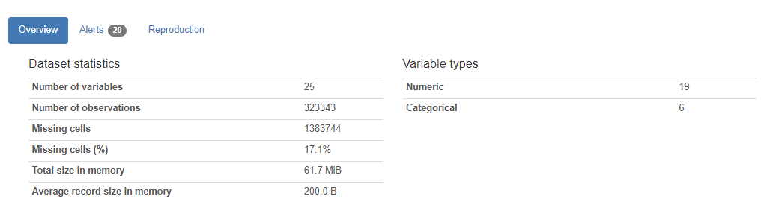
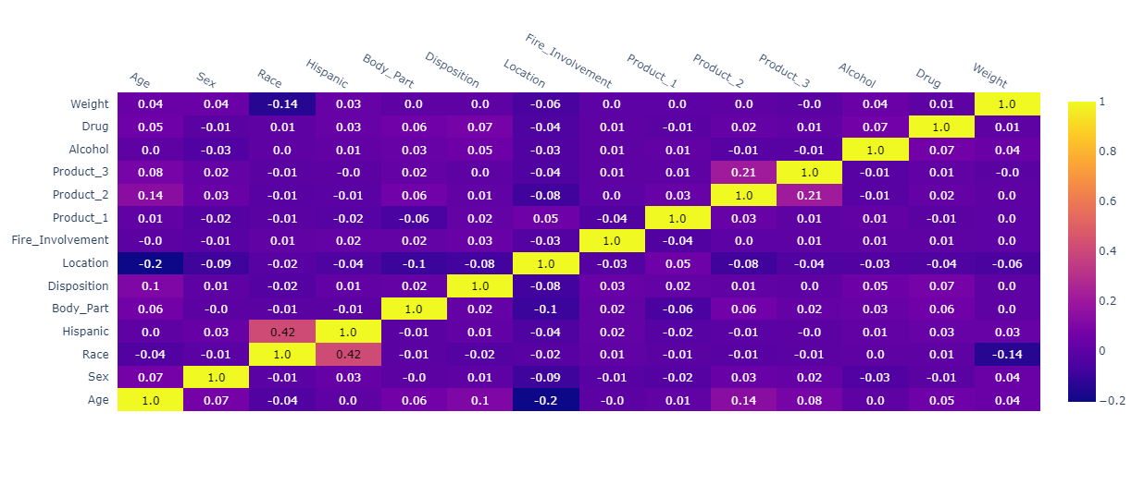
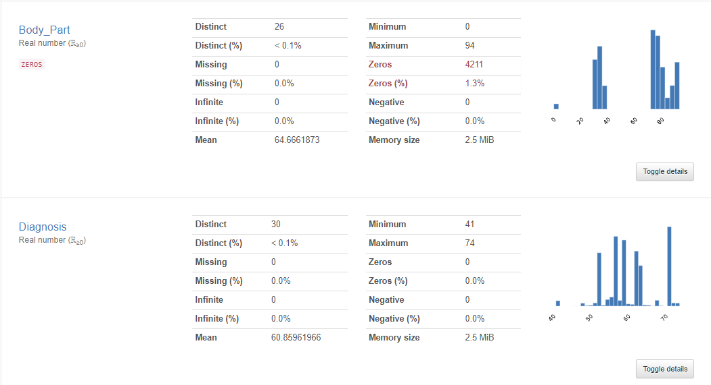
Exploratory Data analysis
Using Pandas Profiling and Plotly the following reports were generated
The overall report includes variable deep dives, interactions between variables, missing values analysis, etc.
Pandas Profiling - Overview Report
Plotly - Correlation Matrix
Target Variables - Overview

Slide 7
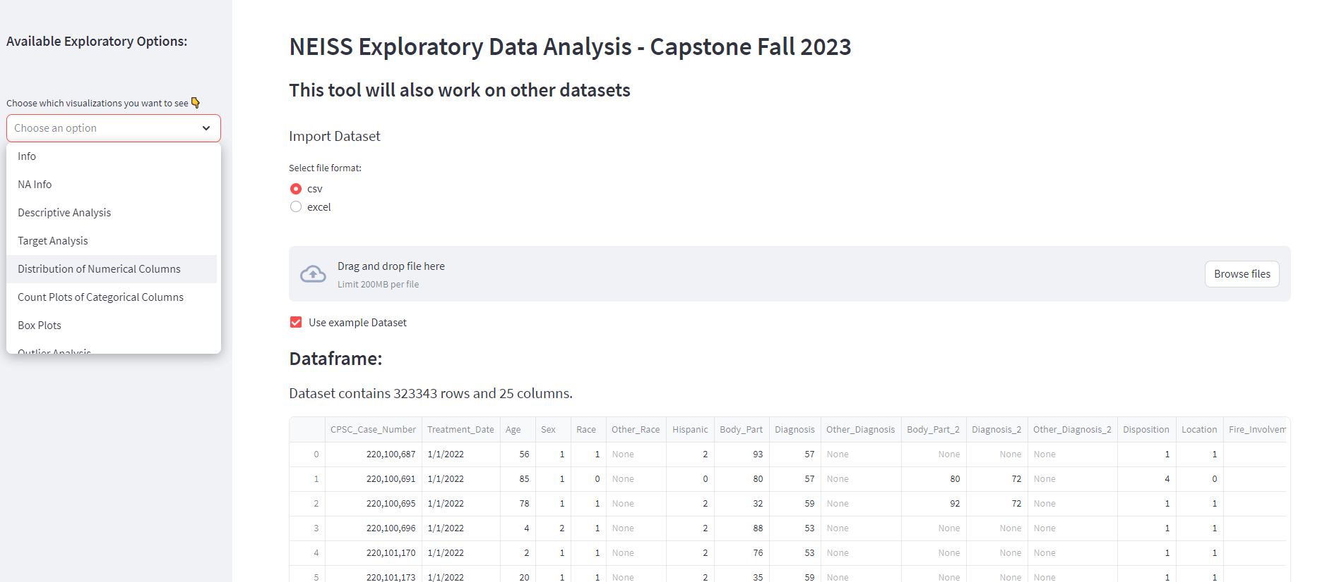



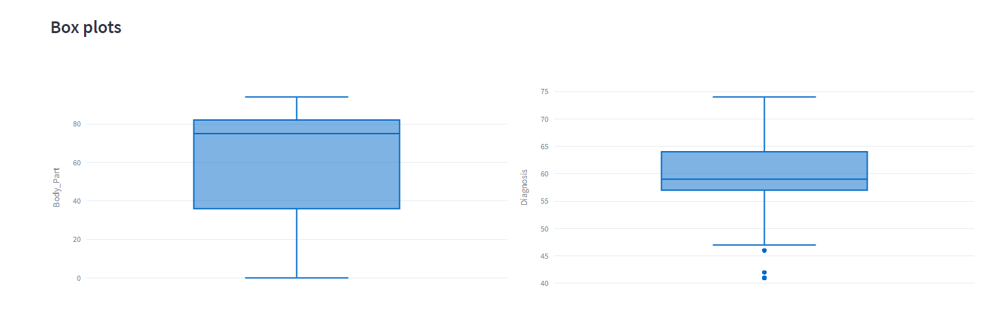


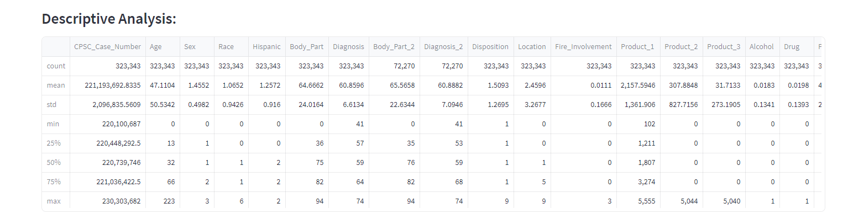
EDA Application Demo
Technologies Used

Slide 8
Model overview + Next Steps
Initial Models Tested:
Random Forest*
XGBoost (plus RandomizedSearchCV)*
Logistic Regression
Support Vector Machines
Next Steps:
Test other models
Hyperparameter tuning
Feature selection
Ensemble methods
Lessons Learned…so far
Computation Time
Memory Limitations
Data correlation
* Better performing models
Notes:
Hyperparameter Tuning:
Grid Search/Random Search: These are exhaustive methods to search through a predefined set of hyperparameters.
Bayesian Optimization: A more efficient method than the exhaustive search, especially for models with many hyperparameters like XGBoost.
Cross-Validation: Always use cross-validation to get an unbiased estimate of the model's performance.
Feature Selection:
Recursive Feature Elimination (RFE): This can be especially effective with SVM and Logistic Regression.
Feature Importance: Algorithms like RF and XGBoost provide feature importance scores. You can use these scores to select a subset of the most influential features.
Regularization: L1 regularization (Lasso) can help in feature selection by pushing some feature coefficients to zero, especially in Logistic Regression.
Ensemble Methods:
Bagging: Like using multiple random forests.
Boosting: Algorithms like AdaBoost, Gradient Boosting Machine (GBM), and XGBoost.
Stacking: Train multiple classifiers and use another classifier or regression model to make the final prediction based on the outputs of the first-layer classifiers.

Slide 9
conclusion

Slide 10
references

